Slide 1
Texas Derby – Austin, Dallas, or Houston?
Yuhao Sun
IBM Data Science Professional Certificate Capstone Project

Slide 2

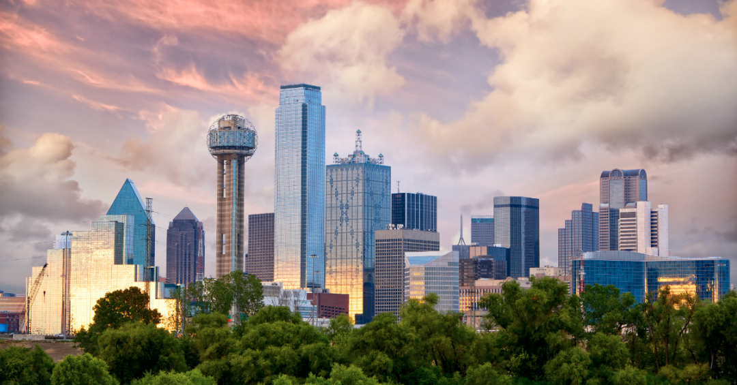
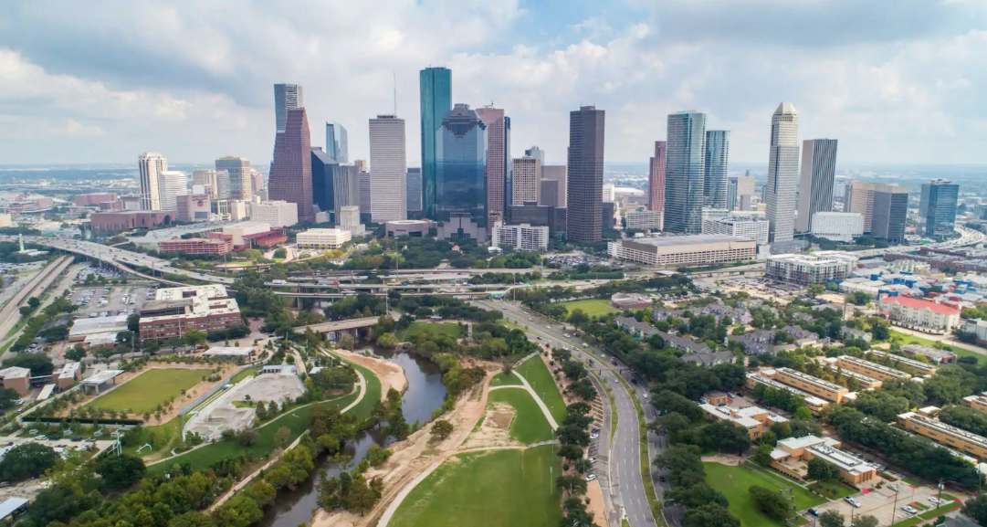
Business Problem
Austin
Texas has been consistently ranked number one for the inflow of migrants from other states across America due to employment opportunities and relatively low living costs.
Most of the people inflow will settle down in one of the three cities (Austin / Dallas / Houston).
Which city among the three is the most convenient in terms of living facilities?
Dallas
Houston

Slide 3

Business Problem
This comparison can help People moving from one city to the other to filter for areas similar (or even different, if you are up for something new) to what you are used to.
This comparison can help People moving from other states to Texas to filter for neighborhoods similar or different from their original came from, and introduce them into local fun and popular places
Companies expanding within one of the cities might want to look for a similar type of neighborhoods, as they are targeting a specific user group. The comparison can offer the first indication.
Companies expanding from one city to the other can use their experience from the original city and look for a fitting (e.g., similar) neighborhood in the second one.

Slide 4
Data Collection
Wikipedia. List of cities in Texas Counties
SimpleMaps.com US Zip Codes and Location
Foursquare API. Top venues and their categories for each city

Slide 5
Methodology
data processing and cleaning
k-means clustering algorithm to identify patterns in the data, k=8
data/clustering visualization with Folium
data scraping using Foursquare API. top 10 venue categories for each city’s vector profile for clustering
exploration data analysis (EDA)

Slide 6
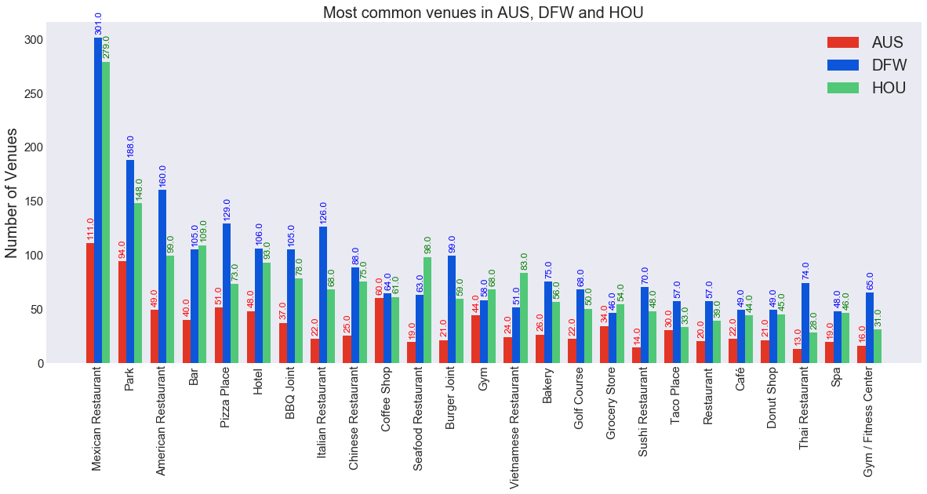
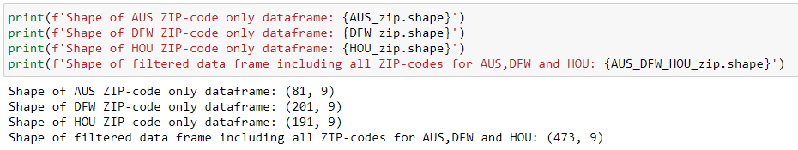
Results/Discussion
EDA
For a better comparison, we should look at those numbers when normalized with the number of inhabitants of all three cities.
Normalized data shows that, in general, AUS is the most convenient city amongst the three. It almost topped every category
Mexican restaurants are still the most popular venue for all three cities

Slide 7
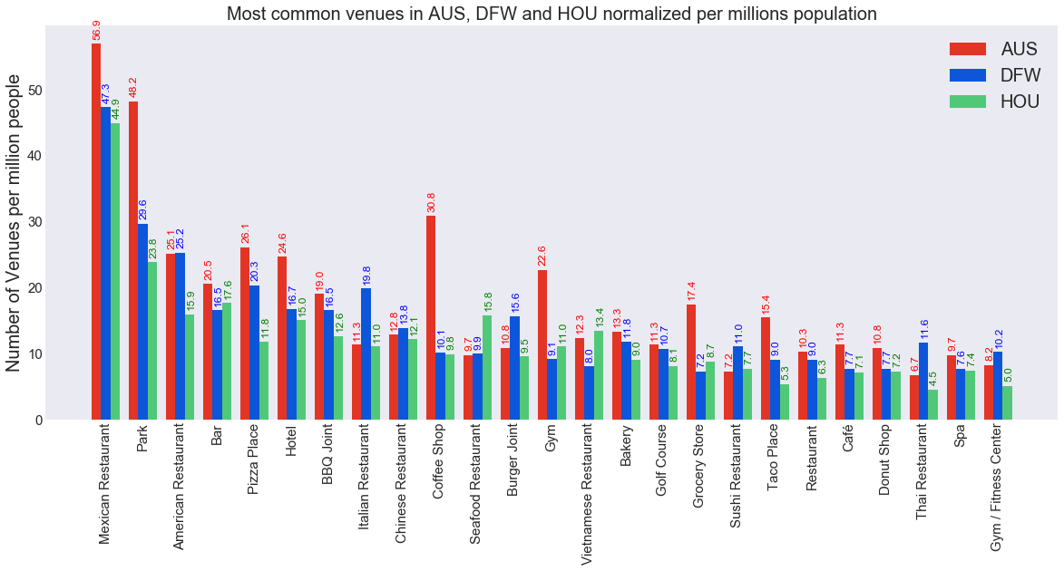
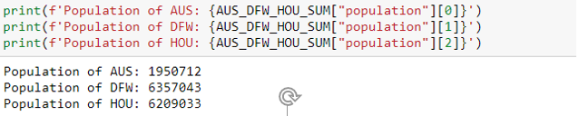
Results/Discussion
EDA
Mexican restaurants are most popular in all cities.
All 3 cities have roughly the same number of coffee shops.
DFW and HOU are about the same size, while AUS is less than half the size of the two mega-cities.
in terms of the absolute number of venues returned, AUS is the least, while DFW is slightly better than HOU overall

Slide 8
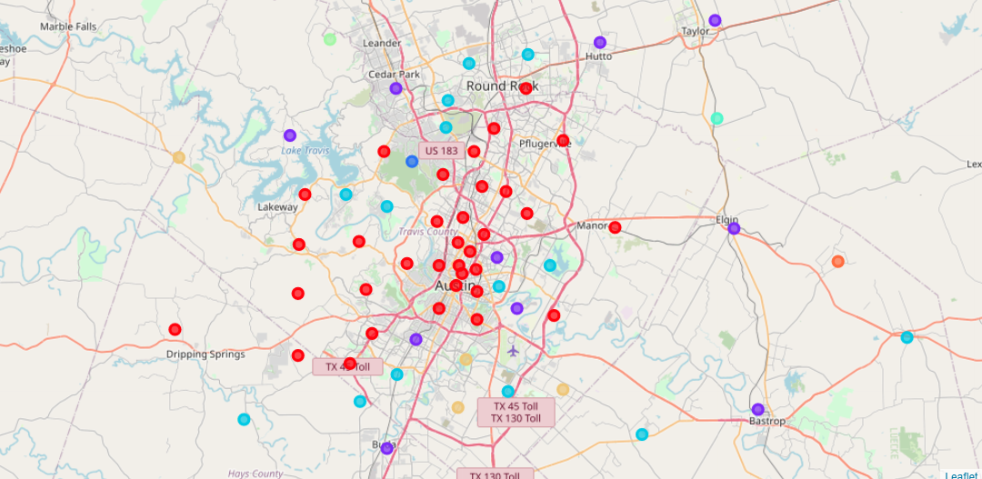
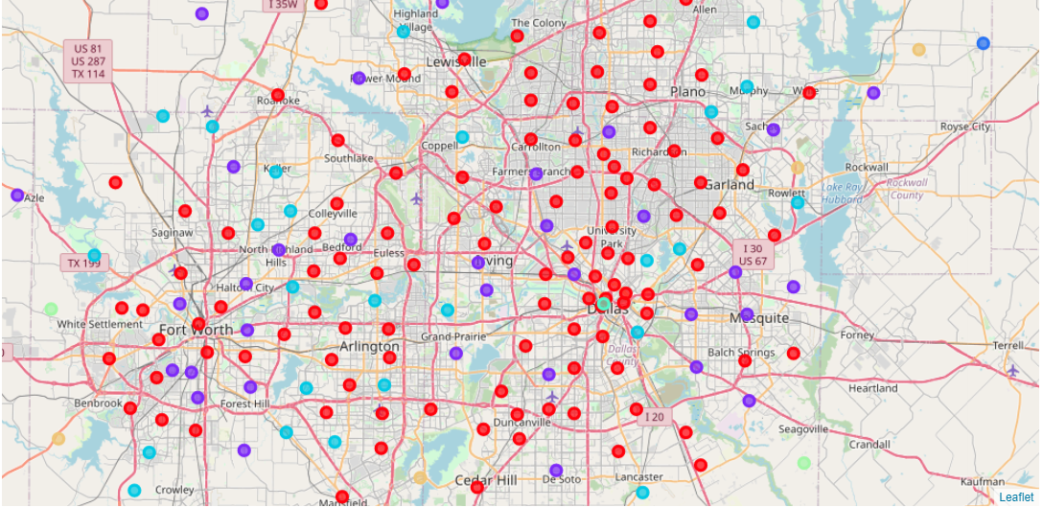
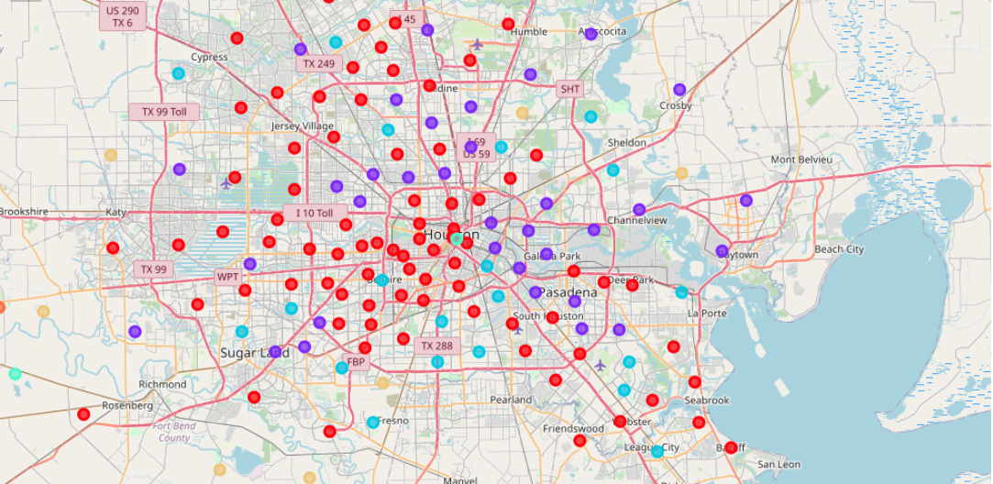
Results/Discussion
Austin
Clusters
As can be seen, certain clusters are more common, while some are unique or rare. This is expected, as some zipcode areas share a common cause, e.g., housing. These neighborhoods fall into the same cluster as they share a similar venue structure. They are close to the city center.
At the same time, zipcode areas located at the center of all three cities share similar trends too. These are more venue crowded neighborhoods.
Dallas
Houston

Slide 9
Conclusion
Austin is the most convenient city among the three in terms of the number of most common venues in the data sets, normalized by the cities population.
For the two major metropolises, DFW is slightly better than HOU.
Texas people love Mexican food, as the number of Mexican restaurants is the most in all three cities.
In general, the three cities have very similar zip code areas/clustering; one should expect roughly the same level of living standard in any of the cities.

